Slide 1
LOAN
STATUS
FORETELLER
A DATA ANALYTIC APPROACH
SUBBMITED BY-
Lakshay chauhan
35496302717
Cse 2nd shift 5th sem

Slide 2
ORGANIZATION PROFILE
01
INTRODUCTION
02
PROCESS & ALGORITHMS
TECHNOLOGY & TOOLS
TABLE OF CONTENTS
04
03
SCREENSHOTS
05
CONCLUSION
06
A brief introduction of the training organization
Describing about the aim and project
The algorithms learned and processes to measure their accuracy
Section about the languages and the technologies that learned during summer training
Screenshots of the project to display is working
What are the outcomes of our project

Slide 3

01
ORGANIZATION PROFILE
TECH EXPLICA
Tech Explica (ISO 9001:2015 Certified Company), is a premiere Talent Development Corporation that includes companies that focus solely on building skilled manpower pool to bridge the gap between the industry requirements and resources.
In 1991, the first company was founded to support the IT industry that was still in its nascent stage to overcome the challenges such as human resources.
It also provides training in Artificial Intelligence,Data Science,Machine Learning,Python,Big Data & Hadoop,R Programming,Cloud Computing,Internet of Things,Ethical Hacking.

Slide 4
02
INTRODUCTION
AIM
Aim of this project is to predict whether the applicant’s loan will get approved or not and maximum loan amount applicant can apply for using a trained machine learning model.

Slide 5
Project description
What this loan status foreteller does is that it takes your information as a input to its trained machine learning model .Now after that it will forecast an output on the basis of the training data it took,whether you are eligible for this loan or not. It will tell you the maximum loan that bank can approve depending on information given.
so saving the precious time of their customer by saving all the hectic running around in banks for loan approval status (whether your loan will get approved or not).

Slide 6






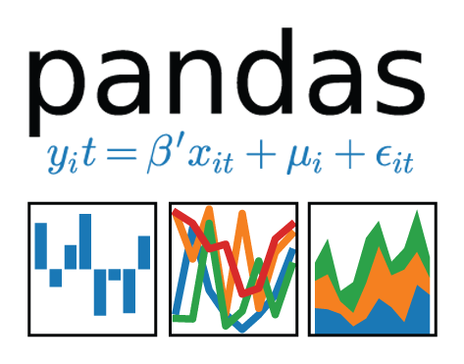
03 TECHNOLOGY & TOOLS
TECHNOLOGY - MACHINE LEARNING AND DATA ANALYTICS
TOOLS -
ANACONDA
GOOGLE COLABORATORY
JUPYTER NOTEBOOK
LANGUAGE-
PYTHON
PACKAGES -
NUMPY
PANDAS
SEABORN
MATPLOTLIB
SKLEARN

Slide 7
04 PROCESS & ALGORITHMS
EDA
DATA PREPARATION
Visualize data to help detect relevant relationships between variables or class imbalances
Wrangle data and prepare it for training
(remove duplicates, correct errors, deal with missing values, normalization, data type conversions, etc.)
OUTPUT /PREDICTIONS
CHOOSE MODEL
RAW DATA
Different algorithms are for different tasks
The raw data is provided which contains only figures without any relation
Parameter tuning
EVALUATING MODEL
TRAIN MODEL
Uses some metric Test the model against previously unseen data
Training our machine learning model with the refined data

Slide 8
ALGORITHMS
K NEAREST NEIGHBOUR
RANDOM FOREST
LOGISTIC REGRESSION
Logistic regression is a statistical model that in its basic form uses a logistic function to model a binary dependent variable, although many more complex extensions exist
Random forests or random decision forests are an ensemble learning method for classification
The KNN algorithm assumes that similar things exist in close proximity. In other words, similar things are near to each other.

Slide 9
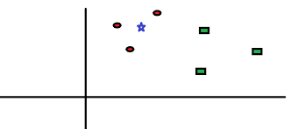
K NEAREST NEIGHBOUR EXAMPLE

Slide 10


Slide 11
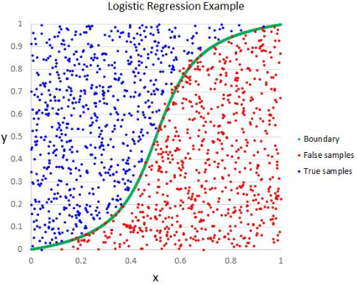

Slide 12
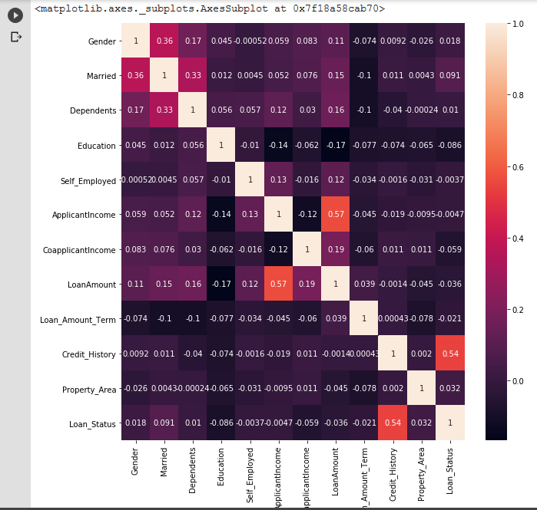
05
SCREENSHOTS
HEATMAP OF CORRELATION
A heatmap is a graphical representation of data that uses a system of color-coding to represent different values. Heatmaps are used in various forms of analytics

Slide 13
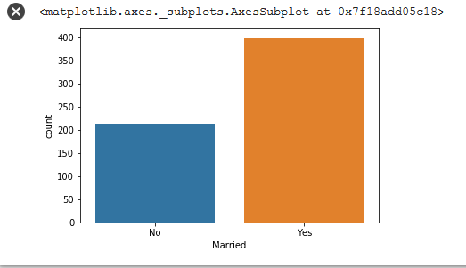
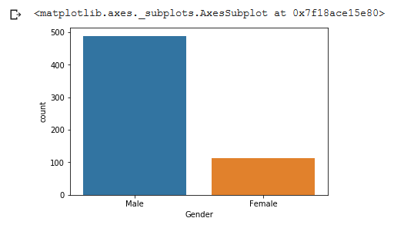
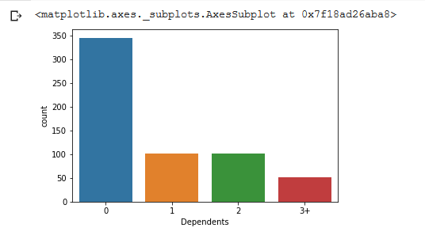
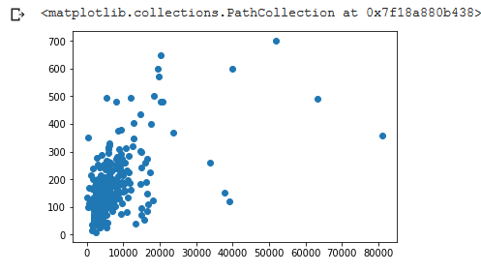
VISUALIZATION
Data visualization is the graphical representation of information and data. By using visual elements like charts, graphs, and maps, data visualization tools provide an accessible way to see and understand trends, outliers, and patterns in data

Slide 14
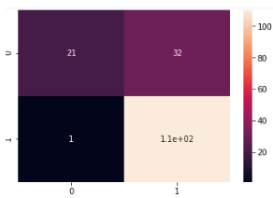
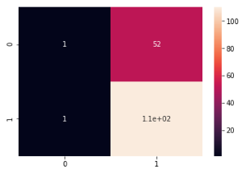
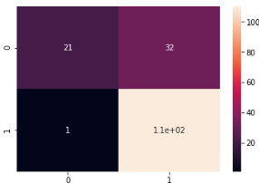
CONFUSION MATRIX
K NEAREST NEIGHBOUR
RANDOM FOREST
LOGISTIC REGRESSION

Slide 15
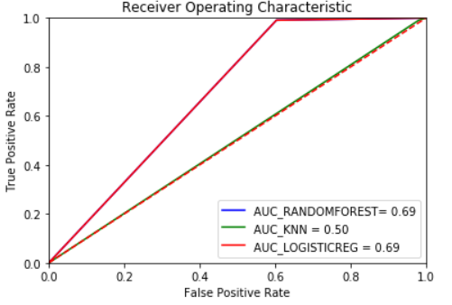
RECEIVER OPERATING CHARACTERISTIC
AUC - ROC curve is a performance measurement for classification problem at various thresholds settings.
It tells how much model is capable of distinguishing between classes. Higher the AUC, better the model is at predicting 0s as 0s and 1s as 1s.

Slide 16
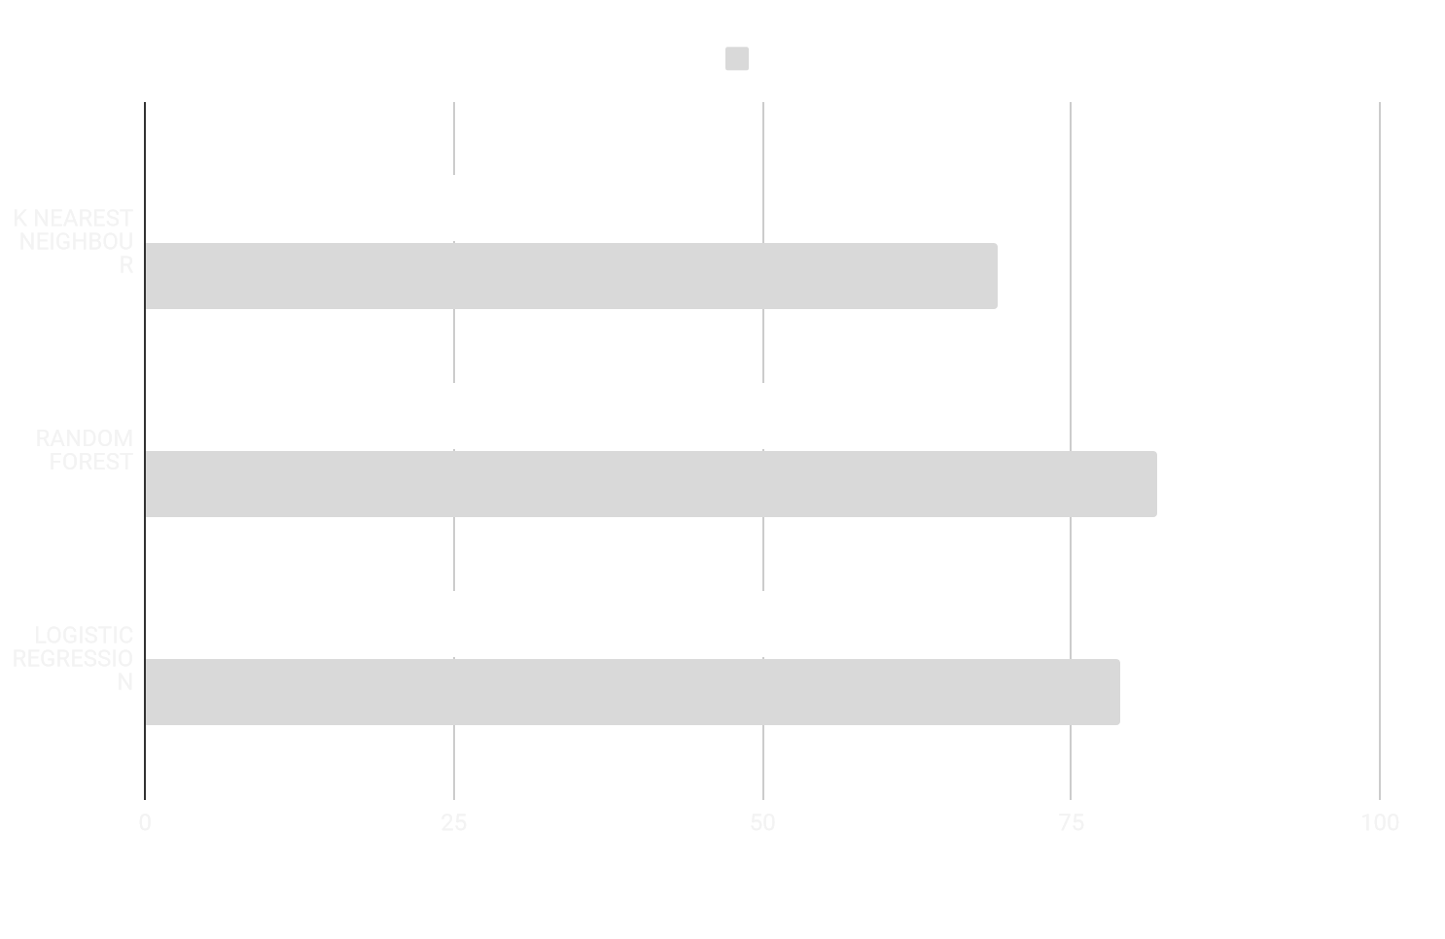
AUC SCORE
ACCURACY SCORE
ACCURACY SCORE
The most common metric for classification is accuracy, which is the fraction of samples predicted correctly
TP+TN/TP+TN+FP+FN

Slide 17
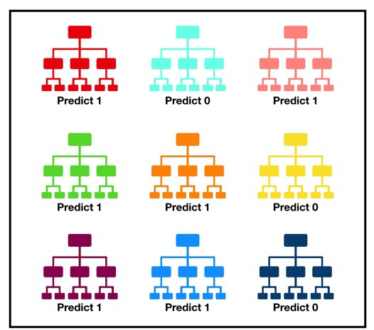
06 CONCLUSION
To conclude this presentation we came to an observation that with random forest classifier these type of problems like loan predictor ,work very well we can also try many other classifiers like support vector machines which make use of kernels.but for now let us end our project with the observation.The fundamental concept behind random forest is a simple but powerful one — the wisdom of crowds.

Slide 18
Thank you

